Slide 1
Introduction to Cyber Law: Cyber Law or the Law and Cyber LAWS8077 – CYBER LAW
Dr Damian Clifford damian.clifford@anu.edu.au

Slide 2
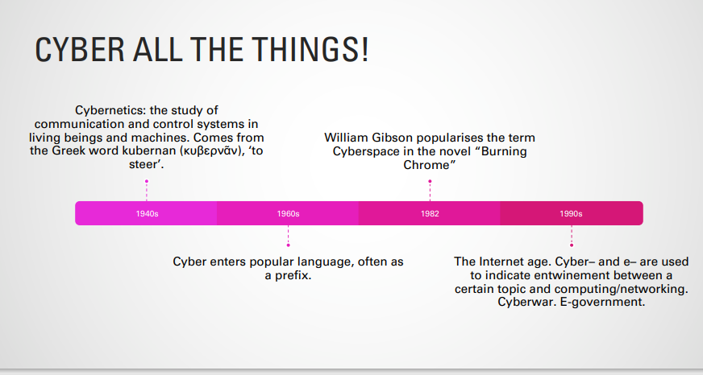
Cyber law?
Notes:
https://www.eff.org/cyberspace-independence

Slide 3
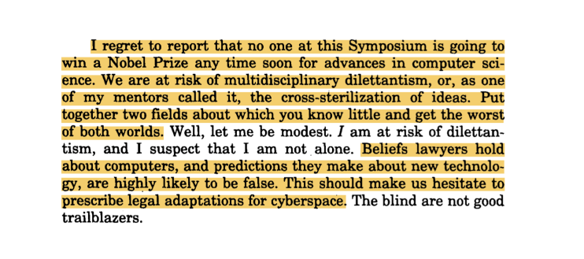
Cyber law?
Does cyber law exist or is it just the law and cyber?
Law and technology not new.
Legislation often aims to be technology neutral
You can break cyber law down into traditional areas of law…
Easterbrook, Frank H. "Cyberspace and the Law of the Horse." U. Chi. Legal F. (1996): 207
Notes:
https://www.eff.org/cyberspace-independence

Slide 4
Cyber law?
Does cyber law exist or is it just the law and cyber?
Perhaps to answer this question we need to consider the difference between online spaces and so-called ‘meat spaces’
Privacy
Freedom of expression/information
IP

Slide 5
Can Cyberspace be Regulated?
The regulability of cyberspace here refers to the capacity of a government to regulate behavior within the limits of its power (see, Lessig, Code and Other Laws of Cyberspace, p.19)
It was once thought that cyberspace could not be regulated, see here:
John Perry Barlow, ‘A Declaration of Independence for Cyberspace’
Johnson, David R., and David Post. “Law and Borders: The Rise of Law in Cyberspace.” Stanford Law Review, vol. 48, no. 5, 1996, pp. 1367–1402.
It was argued that as laws were constrained by borders law could never be effective in in the regulation of the internet
Notes:
https://www.eff.org/cyberspace-independence

Slide 6
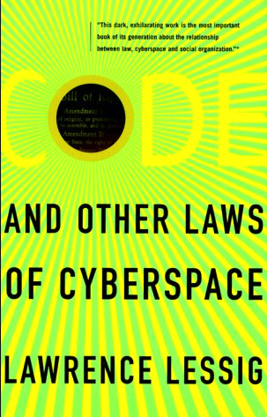
Can Cyberspace be Regulated?
However, this was criticised by many with numerous commentators pointing to the complex array of legislation applicable. As noted by Black and Murray:
‘Of course, in truth little of the Cyberlibertarian argument was true. Resources, in the form or telecommunications bandwidth were scarce, while risks of harm were real in multiple forms from simple copyright infringement or abuse of personal data, through online fraud to online abuse, hate, and threats of violence (including death threats).’
Indeed, the ‘cyberlibertarians’ were criticised by a range of scholars including those focusing instead on the control exercised by those providing access to services. Lawrence Lessig and his book Code and Other Laws of Cyberspace is perhaps the most well-known example.
Notes:
https://www.eff.org/cyberspace-independence

Slide 7
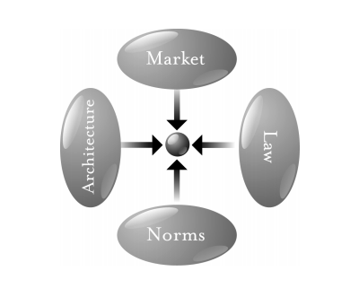
Code is law: The Pathetic Dot and Modalities
Norms – Cyberspace has its own ‘netiquette’
Market – Market constrains in cyberspace
Architecture – ‘Code’ is the equivalent
Law – Direct regulation of cyberspace
Law also indirectly regulates the other 3 modalities
It is necessary to then find the best mix of modalities
Modern regulation will often be a mix of direct and indirect strategies

Slide 8
Code is law and defining “Regulation”
Regulation can be conceptualised in a narrow or wide sense.
Narrowly it can be understood as State attempts to influence citizen behaviour through legal rules and their monitoring and enforcement
In a wider sense regulation can refer to all means of social control imposed by the State or any other social institution.
Therefore, although regulation is primarily undertaken by governments it can also be pursued by non-state actors.

Slide 9
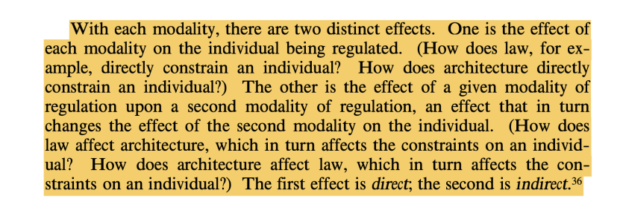
Direct/indirect effects

Slide 10
Different modalities interacting
The law and the market: Certain practices are prohibited
Social norms and the law: Privacy: a social norm that developed into a fundamental human right
The law and architecture/code (and vice-versa): Encryption and wiretapping; export controls and encryption
Code and the market and social norms: Cryptocurrencies
The law and architecture/code and markets and social norms: P2P file sharing and IP law and technical protection measures and anti-circumvention laws and “you wouldn’t download a car”

Slide 11
Taking the example of smoking, how do these modalities fit with the constraining of certain social behaviour?

Slide 12
Code is law: The Power of Code
Lessig suggests that in cyberspace, certain modalities are weakened but that architecture (code) is particularly strong.
i.e. the regulatory effects of laws are weakened by the global nature of the internet, norms are weakened by inter alia remoteness, anonymity, pseudonymity.
Market controls remain strong but market inefficiencies are exacerbated.
‘One increasingly important element is code. In cyberspace in particular, but across the Internet in general, code embeds values. It enables, or not, certain control. And as has been the focus of this part, it is also a tool of control—not of government control, at least in the cases I’ve surveyed— but instead control to the end of whatever sovereign does the coding.’ [Lessig, 2005]
Lessig suggests that the key role of code means that there is a conflict between legal regulatory designs and environmental regulated designed resulting in lawmakers having to resort to indirect regulation through mandatory code designs.

Slide 13
What do you think of Lessig’s argument? Who actually controls code? Is it a problem that many of the services we rely upon today are based in Silicon Valley?

Slide 14
Code as a constraint but also a influencer of behaviour
A choice architecture is a tool which can feed back information and provide options in a libertarian paternalistic way and the choice architect organises the context in which people make decisions.
Libertarian paternalism or ‘nudging’ are interventions designed to counter-act the mental heuristics and biases which give rise to irrational behaviour.
Nudging as a concept owes its origins to a book written by Thaler and Sunstein in 2008. In their analysis the authors offer a broad interpretation of the notion of a nudge and define it as ‘[…] any aspect of the choice architecture that alters people’s behaviour in a predictable way without forbidding any options or significantly changing their economic incentives.’
Notes:
Richard H Thaler and Cass R Sunstein, Nudge: Improving Decisions about Health, Wealth, and Happiness (Yale University Press 2008).

Slide 15
Code as a constraint but also a influencer of behaviour
Baldwin classification of nudges for public policy:
Nudges which aim to enhance rational thinking, hence respecting autonomy and individual decision making.
Nudges which build upon an existing behavioural or volitional limitation in order to bias a decision in a desired direction.
Nudges which incorporate behavioural manipulation the result of which renders reflection futile as it only further enhances the pursuit of a ‘shaped preference’

Slide 16
Code as a constraint but also a influencer of behaviour
The harnessing of biases for commercial purposes has been analysed in the context of behavioural economics and is referred to as market manipulation.
Hanson and Kysar introduced the market manipulation theory in three articles published almost twenty years ago. The authors emphasised the key contention that commercial entities will respond to market incentives and manipulate consumer perceptions in the way which maximises profits.
Ryan Calo then analysed ‘Digital Market Manipulation’ in light of the intense reliance on technology and increased datafication of our everyday lives.
As a consequence, firms can generate a fastidious record of their transaction with the consumer and, importantly, personalize every aspect of the interaction. This permits firms to surface the specific ways each individual consumer deviates from rational decision making, however idiosyncratic, and leverage that bias to the firm’s advantage. Whereas sellers have always gotten a “feel” for consumers, and although much online advertising today is already automatic, this new combination of interpersonal manipulation with large-scale data presents a novel challenge to consumers and regulators alike.’
Notes:
Jon D Hanson and Douglas A Kysar, ‘Taking Behavioralism Seriously: The Problem of Market Manipulation’ (1999) 74 NYUL Rev. 630; Jon D Hanson and Douglas A Kysar, ‘Taking Behavioralism Seriously: Some Evidence of Market Manipulation’ [1999] Harvard Law Review 1420; Jon D Hanson and Douglas A Kysar, ‘Taking Behavioralism Seriously: A Response to Market Manipulation’ (2000) 6 Roger Williams UL Rev. 259.
Ryan Calo, ‘Digital Market Manipulation’ (2014) 82 George Washington Law Review 995, 1002–3.

Slide 17

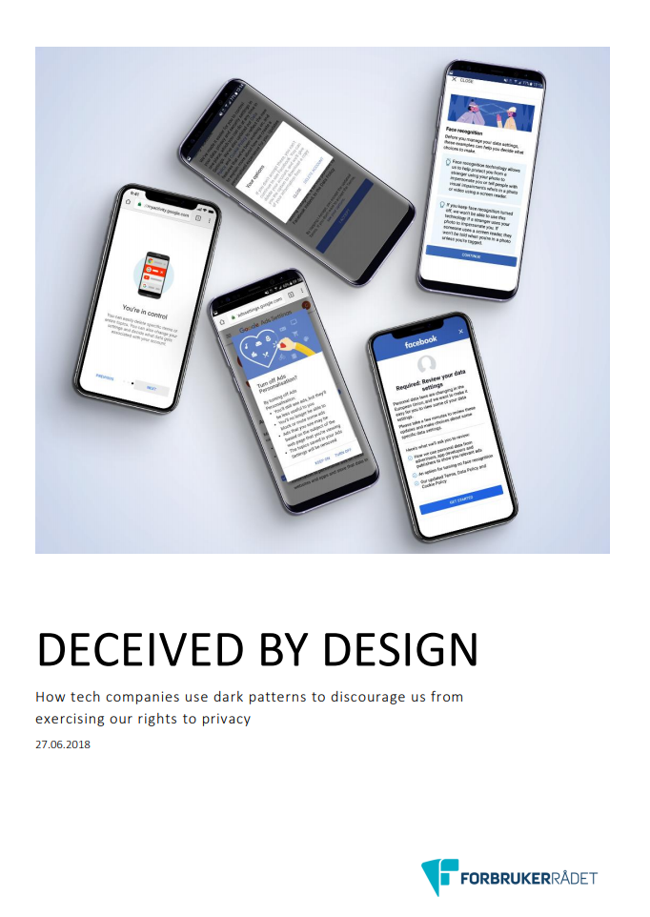

Slide 18
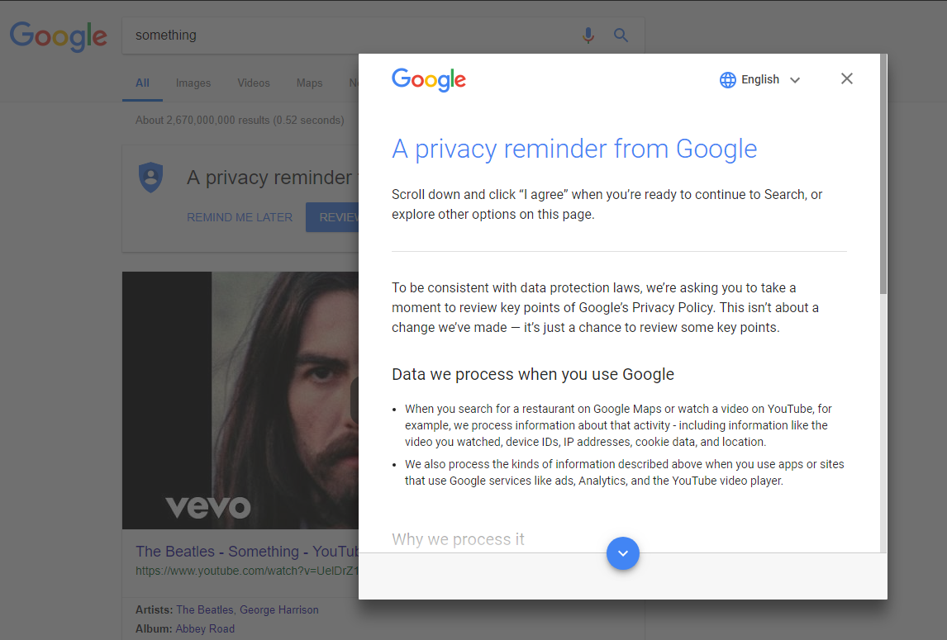
Code as a constraint but also a influencer of behaviour
Colin M Gray Cristiana Santos, Nataliia Bielova, Michael Toth, Damian Clifford, ‘Dark Patterns and the Legal Requirements of Consent Banners: An Interaction Criticism Perspective’, Proceedings of the 2021 CHI Conference on Human Factors in Computing Systems, May 2021 Article No.: 172, 1–18.

Slide 19
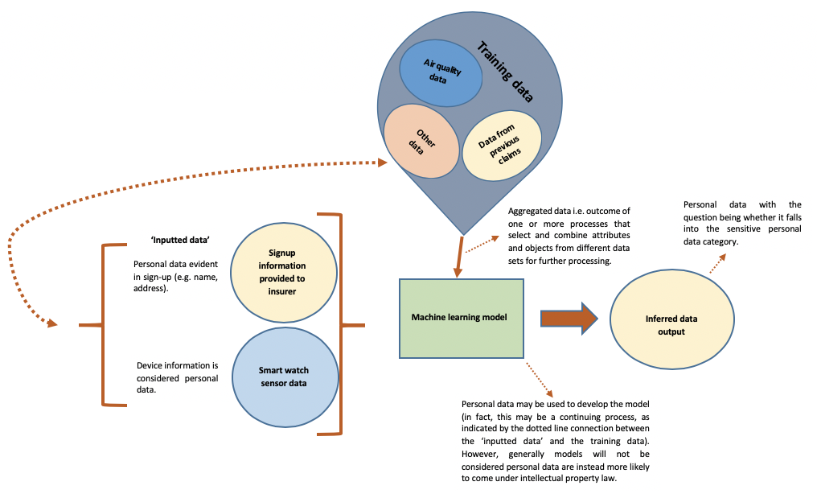

Code, Algorithmic Regulation and Big Data
“Big data are high volume, high velocity, and high variety information assets that require new forms of processing to enable enhanced decision making, insight discovery and process optimization” (Gartner 2012)

Slide 20
Code and Algorithmic Regulation
‘Algorithmic regulation refers to decision-making systems that regulate a domain of activity in order to manage risk or alter behaviour through continual computational generation of knowledge from data emitted and directly collected (typically in real time on a continuous basis) from numerous dynamic components pertaining to the regulated environment in order to identify and, if necessary, automatically refine (or prompt refinement of) the system’s operations to attain a pre-specified goal.’
Karen Yeung
Notes:
Karen Yeung, 'Algorithmic regulation: A critical interrogation', Regulation and Governance, (2018) 12, 4, 505.

Slide 21
Code and Algorithmic Regulation
For example, here we can think of the impact of:
Automated decision-making systems or
Recommender systems
Both are forms of “algorithmic regulation”.
Notes:
Karen Yeung, 'Algorithmic regulation: A critical interrogation', Regulation and Governance, (2018) 12, 4, 505.

Slide 22
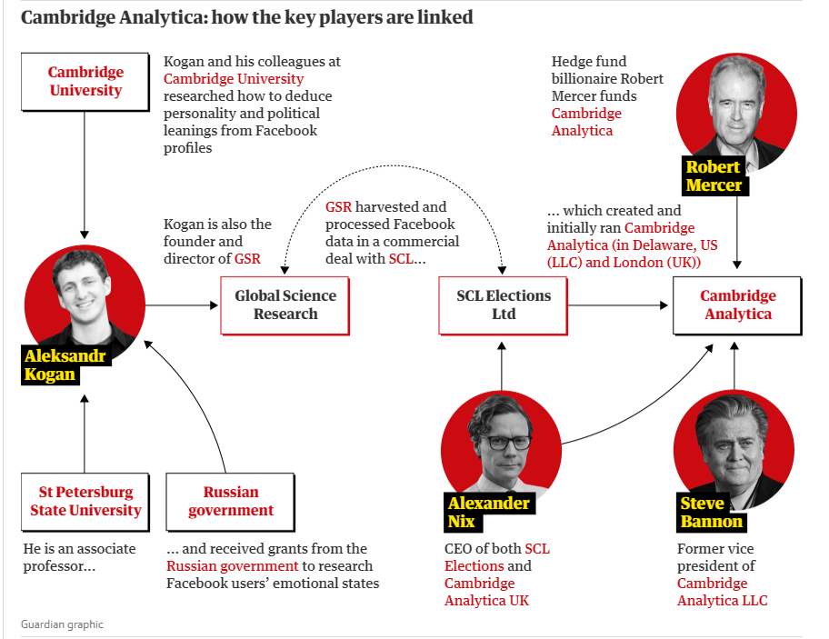
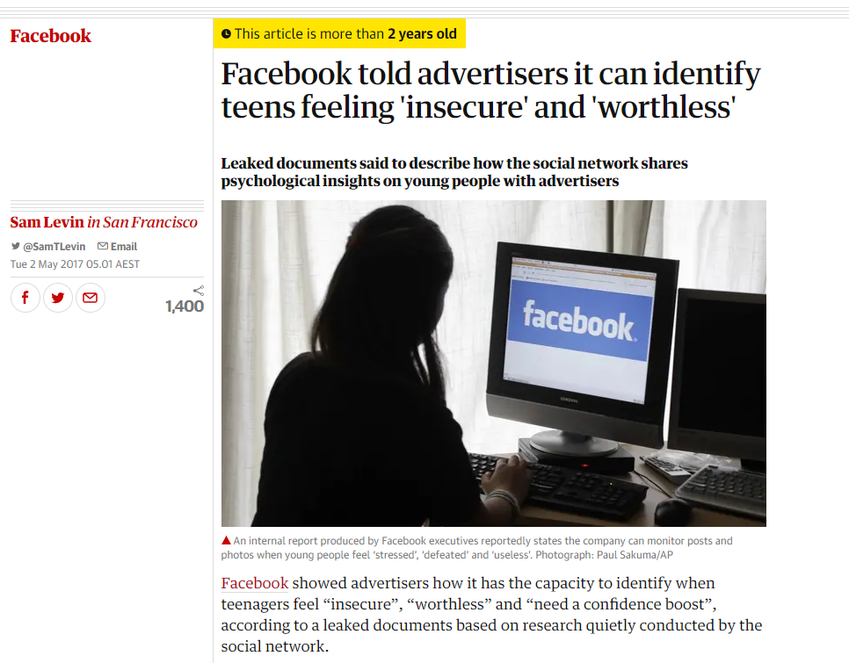
Code and Algorithmic Regulation
Notes:
Karen Yeung, 'Algorithmic regulation: A critical interrogation', Regulation and Governance, (2018) 12, 4, 505.

Slide 23
Algorithmic Regulation and Unfairness
‘Algorithmic decision-making processes raise a crucial additional set of fairness-based concerns. These are autonomy-related concerns that also involve harms to individual dignity. Algorithmic decision-making pro- cesses often use personal information without the person's informed consent. Moreover, the analysis also affects individuals in a seemingly arbitrary manner ("punishing people for things they did not do" is a common complaint). It does not enable their understanding of the process's inner workings, or how it impacts on and is impacted upon by their daily lives. In addition, these processes create an environment in which individuals have a limited ability to question the process or submit corrections, and many such concerns have been identified by the law….
Several of these concerns are linked to the automated nature of the pro- cess, which could contribute to the sense of arbitrariness it generates. An automated response also limits receipt of a concrete, human explanation of the outcome and any chance of fully understanding the process affecting the individual. Furthermore, almost all of the concerns noted here are linked to the opaque nature of the algorithmic process.’
Tal Zarsky
Notes:
Zarsky, Tal. “The Trouble with Algorithmic Decisions: An Analytic Road Map to Examine Efficiency and Fairness in Automated and Opaque Decision Making.” Science, Technology, & Human Values, vol. 41, no. 1, 2016, pp. 118–132.

Slide 24
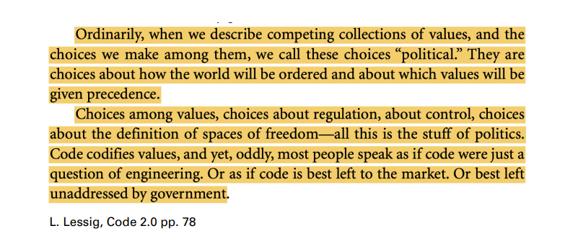
Code and the displacement of values

Slide 25
Code and the displacement of values
Technology is political, despite the ‘technology is neutral slogan’ (i.e. artefacts have politics, see references in notes).
Effects of this are worsened as we don’t know the effects of the technology ex ante but then this can become entrenched (D Collingridge, The Social Control of Technology, 1980, p. 11, as referenced in Liebert and Schmidt. "Collingridge’s dilemma and technoscience." Poiesis & Praxis 7.1-2 (2010).)
‘The social consequences of a technology cannot be predicted early in the life of the technology. By the time undesirable consequences are discovered, however, the technology is often so much part of the whole economics and social fabric that its control is extremely difficult. This is the dilemma of control. When change is easy, the need for it cannot be foreseen; when the need for change is apparent, change has become expensive, difficult and time consuming.’

Slide 26
Technological neutrality
Technology is political, and has regulatory capacity, and regulating it is hard.
Lawmakers pursue technological neutrality and there are 3 main conceptions of technological neutrality in literature
Law should provide for technology-specific provisions, so online can be regulated like offline
Law should not discriminate between technologies with the same functionality
Law should be future-proof, as technology changes rapidly, and law-making is slow
See: Hildebrandt M and Tielemans L, ‘Data Protection by Design and Technology Neutral Law’ (2013) 29 Computer Law & Security Review 509

Slide 27
Policymaking through technology
Reidenberg (1997) defines lex Informatica as the formulation of policy rules through code/tech.
Think about regulating content transmission, IP, and privacy before and after the internet age.
Each example has been displaced, but also enforced and reinforced, by policy rules (≠law) expressed by technology.
For example privacy has been displaced by OBA but then reinforced by PETS etc.

Slide 28
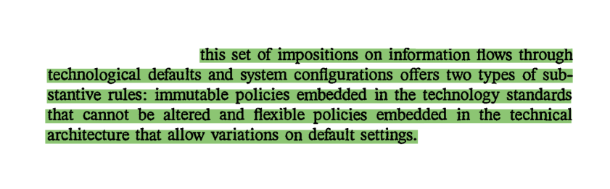
Policymaking through technology

Slide 29
Advantages/disadvanatges of Policymaking through tech nology
Advantages | Disadvantages
Avoids jurisdictional issues | Indirect effects of law on code difficult
Customization for and by individuals | Technocracy
Enforced by code | Lack of nuance
Notes:
1. Jurisdictional advantages: the formulation of policy rules through technology avoids jurisdictional issues ¡ Jurisdictional disadvantages: makes exerting indirect effects of regulation by law on regulation by code difficult 2. Customization advantages: much higher degree of customisation for and by individuals ¡ Customization disadvantages: technocracy; abuse 3. Enforcement advantages: enforced by code, rather than ex post through courts ¡ Enforcement disadvantages: nuances often escape (e.g. fair use

Slide 30
Policymaking through technology
Code may constrain law's ability to deal with a problem, but may also substitute for law when technological rules are better able to resolve policy issues.
Law may support lex informatica, present obstacles to its development, or sanction its circumvention
Legal regulation confronts three tendencies which increasingly marginalize its effectiveness.
1. technological developments outpace the rate of legal evolution.
2. today's technology may limit the ability of government to regulate.
3. information flows may be impervious to the actions of a single government..

Slide 31
Exercise
Use what you have learned about these 4 modalities of regulation to reflect on cyber security. In your groups discuss/find examples that fit into each category

Slide 32
Cyber Security – Some high level points
Effective cyber resilience is an interplay between leadership, governance, risk management, technology and threat modelling.
In the context of a breach there are going to be a whole host of stakeholders to deal with and this demonstrates the complexity of the issue from a governance perspective.
This may be complicated in the context of the complex technology/infrastructure supply chain.

Slide 33
Cyber Security – Some high level points
Who controls the security risks? (vendors of technological solutions, their supply chain and customers)
How do you divide responsibility? Think about the role of commercial and consumer contracts here for instance.
Complexity is a big issue here.

Slide 34
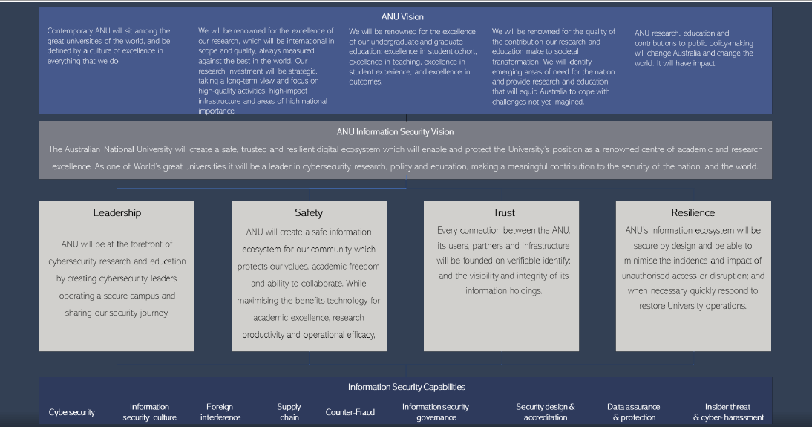
Cyber Security – Some high level points

Slide 35
Cyber Security – Some high level points
An effective cyber security plan involves establishing a security aware culture and it isn’t all about technical solutions
Policies and procedures need to be clear and a focus on improving processes can have a positive impact on behaviour.
It also requires investment.

Slide 36
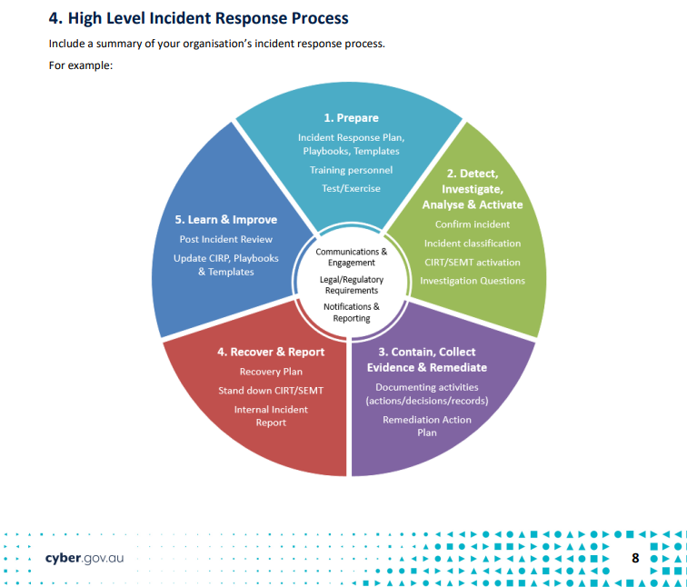
Cyber Security – Some high level points

Slide 37
Cyber (Security) Law: LAWS8077 – CYBER LAW

Slide 38
Introduction to LAWS8077 – CYBER LAW
In this course we explore topics related to cyber security and the law specifically. The course will aim to provide a grounding in some of the key areas linked with the protection of information in the digital environment and how, technological developments threaten our 'security'.
Cyber Security is an area that spans public and private international and domestic law. Given the sheer breadth of this topic, the course will aim to provide a grounding is key topics and some deep dives in specific areas.
Notes:
https://www.eff.org/cyberspace-independence

Slide 39
Introduction to LAWS8077 – CYBER LAW
In this course we explore topics related to cyber security and the law specifically. The course will aim to provide a grounding in some of the key areas linked with the protection of information in the digital environment and how, technological developments threaten our 'security'.
Cyber Security is an area that spans public and private international and domestic law. Given the sheer breadth of this topic, the course will aim to provide a grounding is key topics and some deep dives in specific areas.
Notes:
https://www.eff.org/cyberspace-independence

Slide 40
Introduction to LAWS8077 – CYBER LAW
Seminar | Topic
Seminar 1 | Introduction to Cyber Law: Cyber law or the Law and Cyber?
Seminar 2 | Cyber, Risk and Human Rights
Seminar 3 | Cyber Security and Australia's Law and Policy Patchwork
Seminar 4 | Data Security and Data Privacy/Protection
Seminar 5 | Public-Private Partnerships, Cyber Security and National Security
Seminar 6 | Trade Secrets, Confidentiality and Whistleblowing
Seminar 7 | International Law, Cyber Security and Cyber War
Seminar 8 | Cyber Attacks and Cybercrime as a Business
Seminar 9 | Regulating for Security - A case study: Deepfakes and Electoral Security

Slide 41
Assessments
AT1 Three Blog Posts - 30% A note about the three due dates: Please note that the due dates for Blog Posts 1 and 2 are recommended, but not strict. For Blog Post 3, the due date is strict. You need to submit all three Blog Posts by 29 April 2022 at the latest. If you are going to be late submitting your three Blog Posts, you will need to seek an extension in order to avoid a penalty. A note about content: All blog posts should contact at least two cited sources. You may reflect on content provided in the week before or you may want to blog in relation to something that will find its way into your Research Essays. Blog post 1: 5 pm, Friday 15 April 2022 (600 words max) Blog post 2: 5 pm, Friday 22 April 2022 (600 words max) Blog post 3: 5 pm, Friday 29 April 2022 (600 words max)

Slide 42
Assessments
AT2 Quiz - 20%
Students must answer 20 multiple choice questions to be completed within 60 minutes. The questions will focus on knowledge of the terminology, process and rules arising from Sessions 1, 2, 3 and 4 of the course.
Due Date: 8pm, 27 April 2022

Slide 43
Assessments
AT3 Research Essay - 50% The research essay will require students to conduct independent research that investigates a theme, issue or policy related to cyber law. Original research will be required. Essays must include a bibliography, which is excluded from the word count. Word Limit: 3,600 words Due Date: 5 pm, Friday 27 May 2022. Late submissions (without an extension) are permitted, although late penalties will apply.

